Slide 1


ECO-FRIENDLY SHOPPING INTERFACE
PRESENTED BY :
Vidhya G U (3rdYEAR/AI&DS)
Srila S (3rdYEAR/IT)
Mahalakshmi K (3rdYEAR/AI&DS)
Anusuya M (3rdYEAR/AI&DS)
Leka B(3rdYEAR/AI&DS)

Slide 2
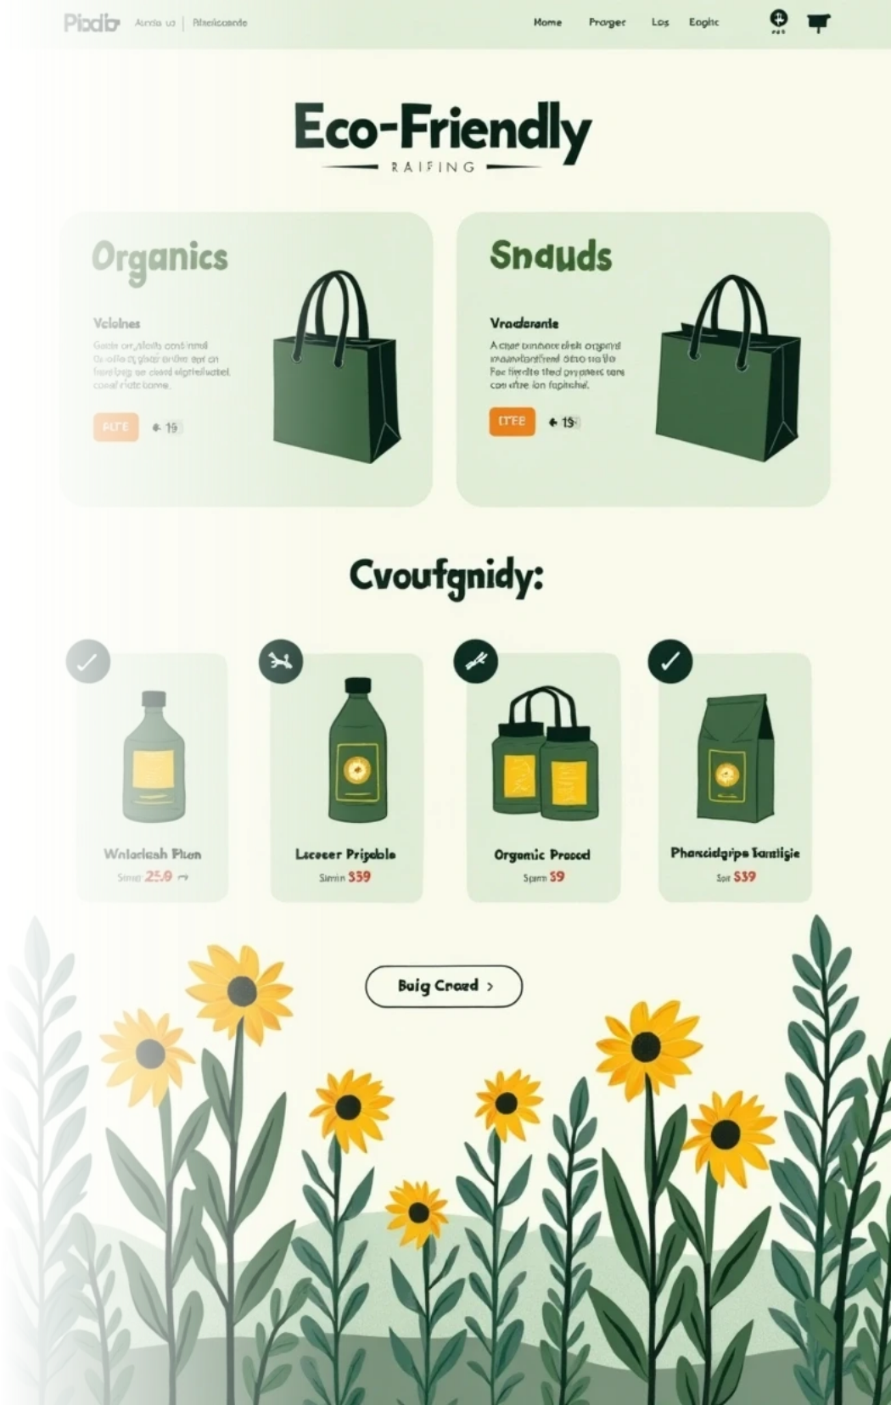
Eco-conscious Shopping Interface
As sustainability becomes more important to consumers, there is a growing awareness of the impact of their purchasing choices. However, many online shopping platforms fail to provide clear and transparent information about product sustainability. This lack of clarity makes it challenging for shoppers to make informed decisions that align with their values, highlighting the need for a dedicated eco-conscious shopping interface.

Slide 3

The Importance of Sustainability
Growing Consumer Awareness
As environmental issues gain media attention, consumers are more mindful of their ecological impact.
Impact on Purchasing Habits
Users are seeking brands that align with their values, influencing their purchase decisions.
Market Shift
Businesses that embrace sustainability may gain a competitive advantage.

Slide 4



Current Online Marketplace Challenges
The online marketplace faces several critical challenges that affect consumer awareness and sustainability. Addressing these issues is essential for promoting informed purchasing decisions and improving the shopping experience.
Difficulties in Comparison
Shoppers struggle to find reliable eco-ratings and certifications, making informed decision-making cumbersome and complex.
2
Lack of Transparency
Many online shopping platforms do not provide clear information on the sustainability of products, hindering consumer choice and awareness.
1
Carbon Footprint Tracking
3
Consumers lack tools to easily track their carbon footprints, limiting their ability to understand the environmental impact of their purchases.

Slide 5
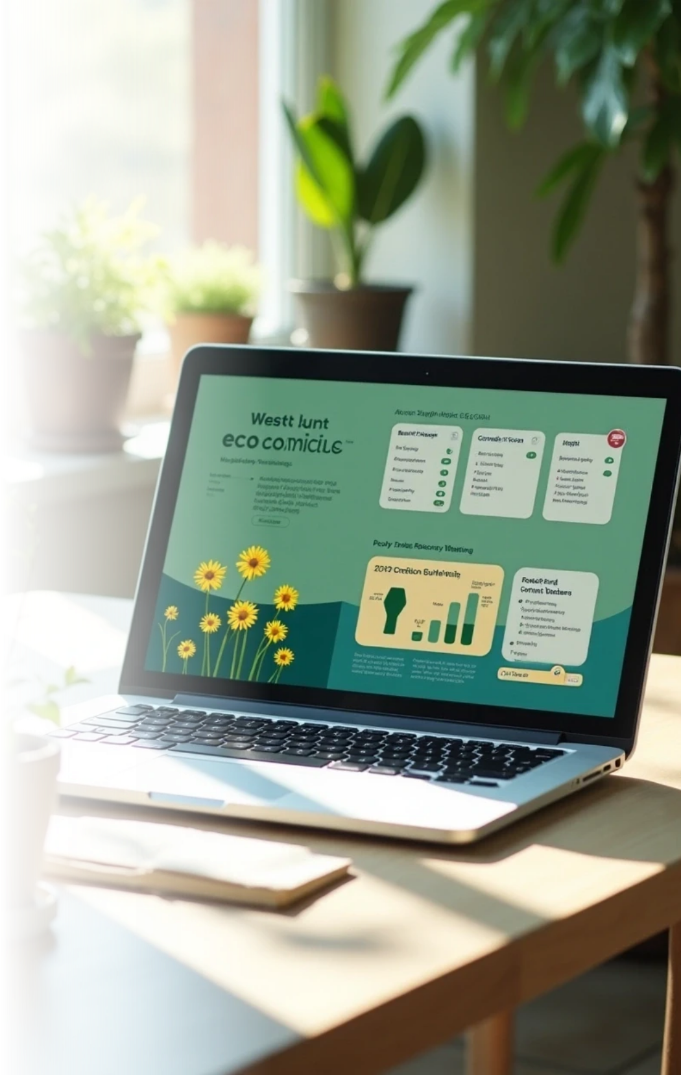





Designing an Eco-Conscious Interface
1
User-Friendly Design
Prioritize ease of navigation for sustainability information.
2
Comparative Tools
Integrate features for side-by-side eco-rating evaluations.
3
Carbon Footprint Calculator
Implement a tracker for understanding personal environmental impact.

Slide 6



Key Interface Features
Eco-Label Certification
Product Lifecycle Information
User Reviews on Sustainability
Displaying recognized eco-labels and certifications prominently will provide credibility, allowing consumers to confidently choose sustainable options.
Offering insights into a product’s lifecycle—from production to disposal—enables a deeper understanding of its sustainability.
Enabling customers to leave reviews specifically addressing sustainability will encourage dialogue and shared experiences among users.

Slide 7



Implementation Strategies
Data Analytics for Personalized Recommendations
2
Partnerships with Eco-Certifying Organizations
Utilizing AI and machine learning can help recommend products aligned with users' sustainability preferences and past purchases.
1
Collaborating with established certifiers can enhance trust and authority in sustainability claims made by products.
Educational Content
3
Providing resources and information on sustainability issues empowers customers to make better decisions.

Slide 8



Measuring Success
1
User Engagement Metrics
Tracking metrics such as time spent on sustainability sections and user interaction rates can gauge the effectiveness of the eco-conscious features.
2
Sales Data Analysis
Evaluating changes in sales of sustainable products over time can help assess the impact of the new interface design on purchasing behavior.
3
Customer Feedback Loop
Creating channels for ongoing customer feedback will help continuously improve the interface based on user experiences and suggestions.

Slide 9





Future Trends in Eco-Conscious Shopping
1
Increase in Eco-Friendly Products
More brands will likely invest in sustainable practices, leading to an increased variety of eco-friendly products available online.
2
Enhanced Technology Integration
Advancements like blockchain for transparency will enhance consumer trust in product sustainability.
3
Rise of Conscious Consumerism
Responsible consumption will influence how businesses operate and engage with consumers.

Slide 10



Conclusion and Call to Action
Informed Decision-Making
By designing an effective eco-conscious shopping interface, we can empower consumers to make informed, responsible purchasing decisions leading towards a sustainable future.
2
Embracing Sustainability
It's vital for online marketplaces to evolve and incorporate sustainability insights into their platforms for a better shopping experience.
1
Collaboration is Key
Businesses, consumers, and organizations must work together to foster practices that emphasize sustainability in everyday purchasing habits and behaviors.
3

Slide 11



Consumer Behavior and Sustainability References
Publications
Research Studies
Eco-Certification Reports
Insights on consumer behavior and sustainability trends.
Studies emphasizing the role of eco-friendly practices.
Impact of transparency in consumer purchasing decisions.

Slide 12





Acknowledgments
1
Sustainability Experts
A special thanks to sustainability experts and researchers whose insights guided the development of this eco-conscious shopping interface concept.
2
Advocacy Organizations
Recognition of the role of organizations advocating for eco-friendly practices and consumer awareness.

Slide 13



Questions & Discussion
Open Discussion
Encourage Feedback
Open the floor to any questions or thoughts regarding the proposed eco-conscious shopping interface.
1
2
Encouraging feedback and suggestions to refine the concept further and enhance its effectiveness.

Slide 14
THANK YOU

